Slide 1
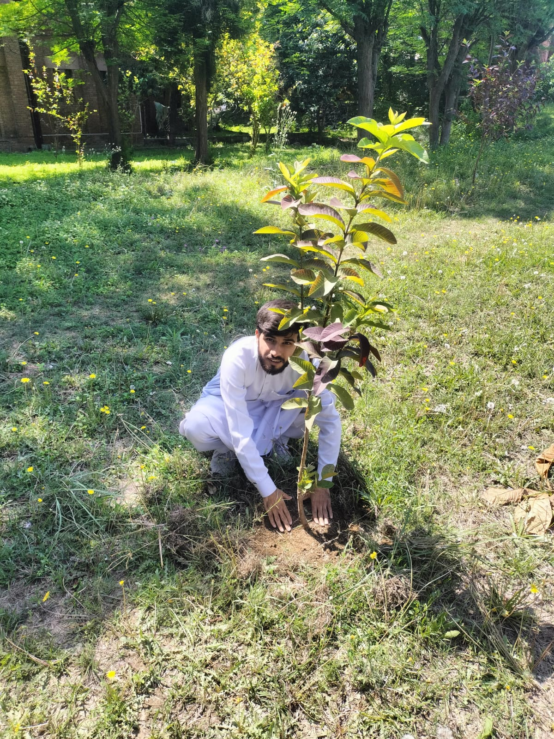
🌱
PLANTATION
DRIVE
Weekly Community Activity
Al-Khidmat Foundation Initiative
Shah Faisal (23I-0058) | Hamad Khan (23I-3095)
3rd April 2026 — Friday

Slide 2
“
He who plants a tree plants a hope.
— Lucy Larcom
🌿 Plantation Activity 🌿

Slide 3
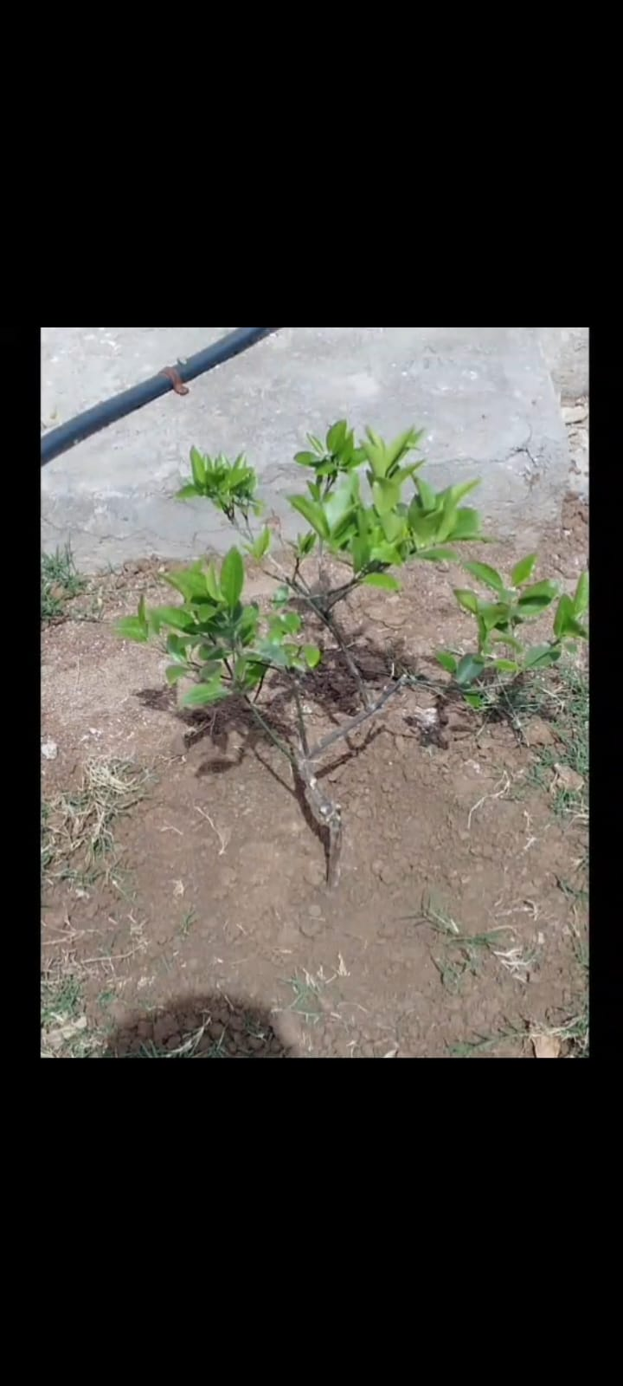
INTRODUCTION & ORGANIZATION OVERVIEW
🏢 Organization
Al-Khidmat Foundation – one of Pakistan's largest welfare organizations, providing humanitarian relief, education, health, and environmental services nationwide.
🎯 Objective
To raise environmental awareness among university students and engage communities through hands-on plantation drives at local public spaces.
📍 Location & Time
Hometown public playground boundary | 3rd April 2026 (Friday) | Duration: ~2 hours | Participants: 2 members
Small citrus sapling planted
at boundary wall

Slide 4
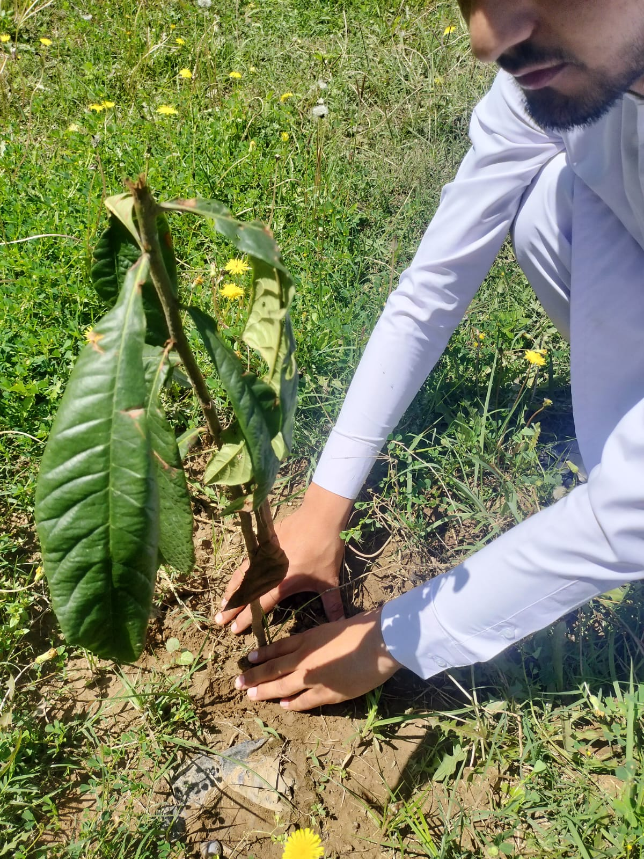
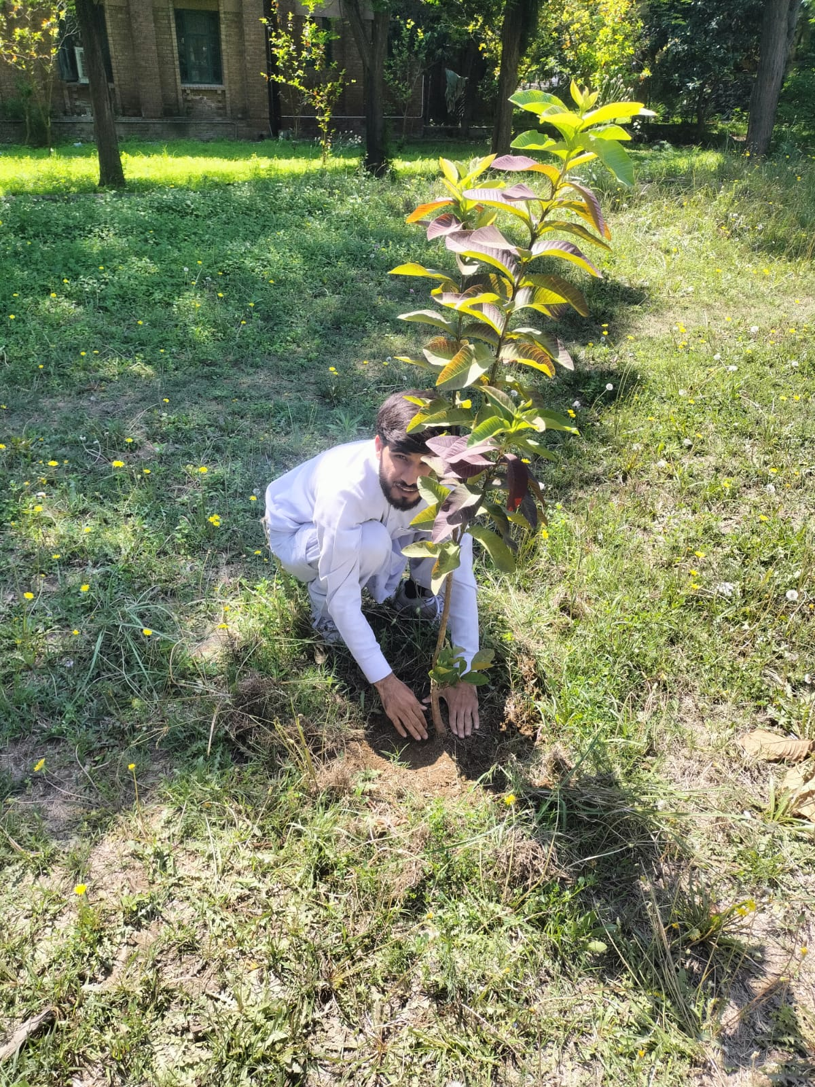
ACTIVITIES PERFORMED
1
2
3
Careful Planting
Pressing the Soil
Sapling Secured
1. Procured 6 healthy saplings — Different type of fruit trees
2. Dug planting holes at the boundary of public playground
3. Planted trees with care, firming soil around each sapling
4. Watered each tree and ensured drip irrigation access where available

Slide 5
🌍 ENVIRONMENTAL IMPACT
🌬️
Air Quality
Each tree absorbs CO₂ and releases oxygen, directly improving air quality for families and children at the playground.
🌱
Soil Health
Tree roots prevent soil erosion, retain moisture, and restore soil nutrients over time.
☀️
Shade & Cooling
Mature citrus and guava trees will provide natural shade, reducing the local heat island effect.
🐝
Biodiversity
Fruit-bearing trees attract pollinators and support local wildlife, enriching the ecosystem.

Slide 6
🤝 COMMUNITY IMPACT
6
2
2 hrs
∞
Trees Planted
Members Active
Time Invested
Lasting Impact
🏞️ Public Space Beautification
👨‍👩‍👧 Family & Children
The boundary of the playground is now greener and more welcoming, directly enhancing the experience of the community members who use it daily.
Children playing at the ground will grow up with trees they can see mature over time, building a natural environmental connection.
🌳 Neighborhood Greenery
💡 Awareness & Inspiration
Six new trees contribute to a greener, cooler neighborhood — a visible, lasting mark of community service.
The act of planting publicly inspires neighbors to take similar steps, creating a ripple effect of environmental consciousness.

Slide 7
📚 STUDENT FEEDBACK & REFLECTION
🤲
Hands-On Learning
Physically planting trees gave us a far deeper understanding of environmental stewardship than any classroom lecture could. Feeling the soil, choosing the right depth, and handling the saplings made the experience real and memorable.
🏢
Understanding Al-Khidmat
This activity gave us first-hand insight into Al-Khidmat Foundation's grassroots approach. We saw how a welfare organization drives community change not through large campaigns alone, but through small, consistent local actions.
🔁
Ripple Effect of Action
Planting in a public space reminded us that individual actions have collective impact. We left with a stronger belief that consistent, small efforts by students can create lasting environmental and social change.

Slide 8
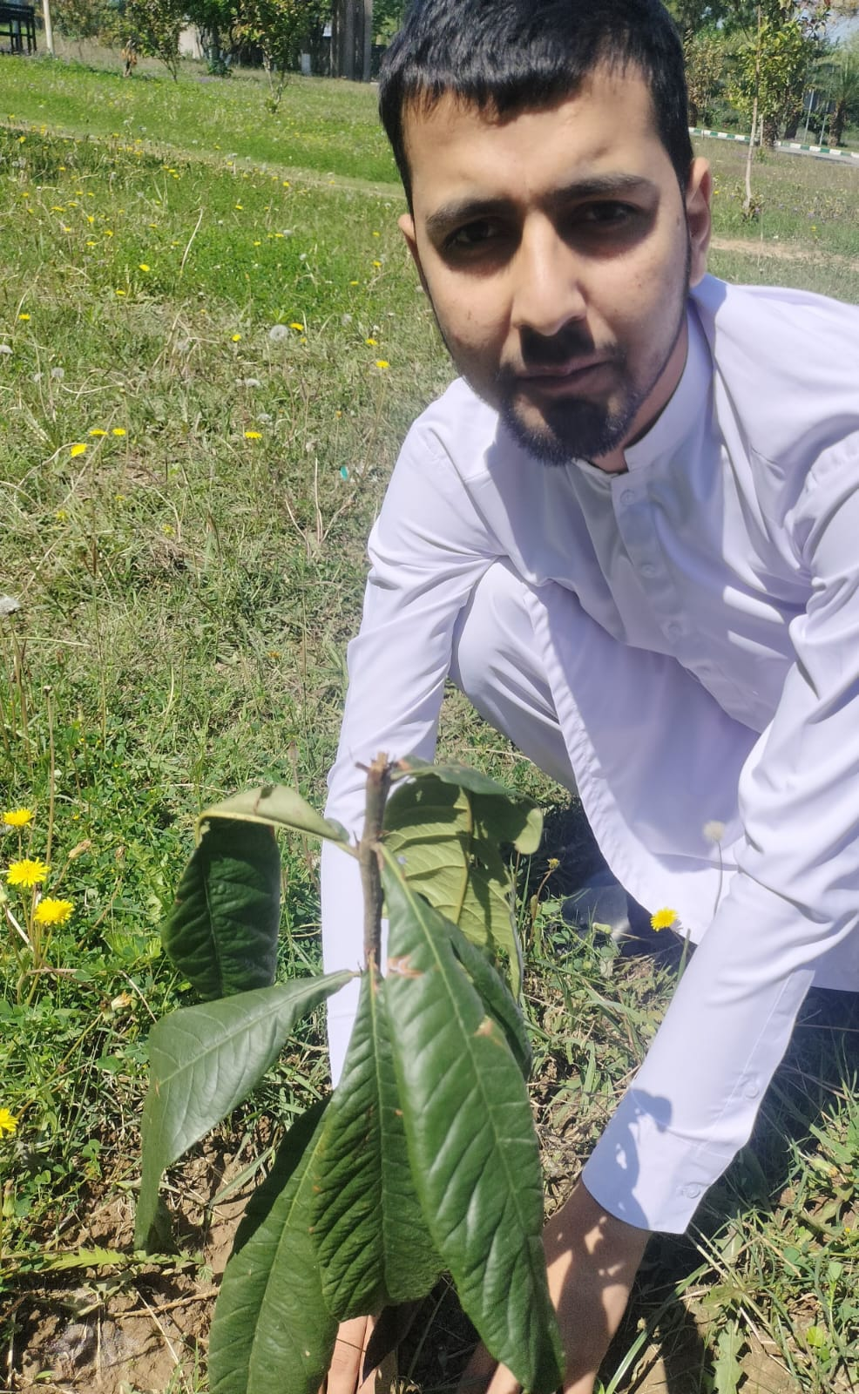
ACTIVITY PHOTO GALLERY
Close-up: Guava sapling
Planting guava in ground
Setting roots in soil
Securing a tall sapling
Small citrus at boundary

Slide 9
🌳
Conclusion
Green Today,
Greener Tomorrow
This plantation activity under Al-Khidmat Foundation's direction gave us the opportunity to contribute meaningfully to our local environment. Six trees planted today will stand for decades, offering shade, cleaner air, and a greener public space for our neighborhood.
Thank You | April 2026

